Slide 1


PYTHON
Project Topics
Lecture -1

Slide 2

Today’s Agenda
GUI Programming-I
Introduction To GUI
How Python Supports GUI
The Tkinter Library
Our First GUI App
Modifying The First App

Slide 3
Our Current Approach Of Programming
Till now we have seen how to write text-only programs which have a CUI interface.
CUI stands for Command User Interface
It is called CUI because:
The output shown by our program is purely textual
It is shown on command prompt
The only way our user can interact with our application is via keyboard

Slide 4
Drawbacks Of CUI
This approach is very good for learning basics of a language.
However when it comes to a real life application or project then CUI is not comfortable for the user.
Our users would like the app to be more realistic , attractive and user friendly.
This is where GUI programming which stands for Graphical User Interface comes into picture.

Slide 5
Introduction To GUI
A GUI program presents an easy-to-use visual display to the user.
It is made up of graphical components (e.g., buttons, labels, windows) through which the user can interact with the application

Slide 6
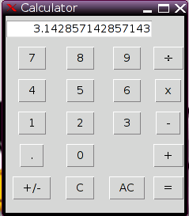
A Sample GUI App

Slide 7
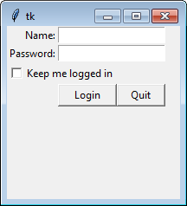
A Sample GUI App

Slide 8
Python’s Support For GUI
In Python we have many predefined libraries for building GUI apps.
The TOP 3 of them are:
Tkinter
PyQT
WxPython
We will be using Tkinter in this course

Slide 9
What Is Tkinter ?
Tkinter ( Tk interface) is standard Python GUI library as it comes packaged with Python and is cross platform.
It gives us an object-oriented interface to the Tk GUI toolkit.

Slide 10
What Is Tk ?
Tk was developed as a GUI extension for a programming language called TCL( Tool Command Language).
It was released in 1991 and was extremely successful as it was very easy to learn and implement.

Slide 11
What Is Tk ?
Due to it’s popularity programmers of many languages incorporated Tk into their language also.
So along with Python many other languages like ADA, Ruby , Lisp etc built up their Tk libraries.
In Python this library was named Tkinter

Slide 12
Important Steps In Tkinter
Here are the steps listed, to keep in mind for creating any GUI applications in Python:
At first , import the tkinter module
Now create the main window of your GUI application
Add one/more widgets to the GUI application
Finally run the event loop that allows user to interact with the application

Slide 13
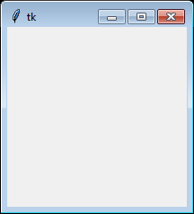
Our First GUI App
import tkinter
tw = tkinter.Tk()
tw.mainloop()
Output

Slide 14
Explanation
import tkinter
We start by importing the tkinter module.
It contains all classes, functions and other things needed to work with the Tk toolkit.

Slide 15
Explanation
tw=tkinter.Tk()
To initialize tkinter, we have to create an object of the class Tk which is normally called the root widget.
This is an ordinary window, with a title bar and other decorations provided by our window manager.
We should only create one root widget for each program, and it must be created before any other widgets.

Slide 16
Explanation
tw.mainloop()
Finally when our window is ready to be displayed we have to call the Tk method mainloop().
This method does 2 things:
Makes the root widget appear on screen
Runs an infinite event loop until we close the window

Slide 17
Modifying The root widget
If we closely observe the output of the previous code we will notice 4 things:
The window is having default title as tk
It is having a default logo
The width and height are 200 * 200
It appears at random location on our desktop
Now we will discuss how to change all these default
settings

Slide 18
Setting Title Of The root widget
To change the title of the root widget we have to call the instance method called title( ) of the class Tk.
This method accepts a string as argument and sets it as the title of the window.
Sample Call:
tw.title("Sachin's GUI App")

Slide 19
Setting Icon Of The root widget
By default the root window comes with the default icon of Tk .
To change this icon we have to take 2 steps:
Create an object of the class PhotoImage present in the tkinter module passing it the image to be used as icon using the keyword argument file
Pass this object as argument to the instance method called iconphoto() of the class Tk , passing it 2 arguments which are the Tk object itself and the PhotoImage object

Slide 20
Setting Icon Of The root widget
Creating object of PhotoImage class
img=tkinter.PhotoImage(file="d:/images/help.gif")
Calling the method iconphoto( ) of the class Tk
tw.iconphoto(tw,img)
A point to remember is that this method only accepts gif and png images but not bmp and jpg images

Slide 21
Setting Size Of The root widget
To change the size of the root window we have to call the instance method geometry( ) of Tk.
This method accepts an argument of string type with the format as “w x h”, where w is width and h is height
Sample Call:
tw.geometry("600x200")
Note that we are using a lowercase “x” here instead of a “*” to essentially say: I want the window to be 600 pixels by (x) 200 pixels.

Slide 22
Setting Location Of The root widget
When the first Tkinter window is run, it will usually appear in the top left hand corner by default at some random location.
To change this we can add the starting x and y coordinates after specifying the height in the geometry() method.
Sample Call:
tw.geometry("600x200+400+250")
Here, we position the top left corner of the window right 400 pixels and down 250 pixels.

Slide 23
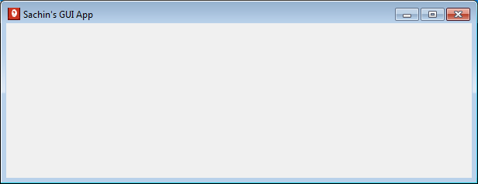
The Complete Code
import tkinter
tw = tkinter.Tk()
tw.title("Sachin's GUI App")
img=tkinter.PhotoImage(file="d:/images/help.gif")
tw.iconphoto(tw,img)
tw.geometry("600x200+400+250")
tw.mainloop()
Output:

Slide 24
Creating a Fixed Size Window
When our gui app will run , the user can change the window width and height by dragging the window edges.
In some cases we don’t want to allow the user to change the window size and for this we can call the instance method resizable( ) of Tk.
This method accepts two boolean arguments representing whether changing width and height is allowed or not
Sample Call:
tw.resizable(False,False)

Slide 25
Centering The root window
To put our main window at the center of the screen , we simply have to follow the below mentioned steps:
Obtain the current screen width and current screen height by calling the method winfo_screenwidth() and winfo_screenheight() of the Tk object
Set the starting coordinates 25% from left and 25% from top
Set the width and height of the window to be half of the screen width and screen height

Slide 26
The Complete Code
import tkinter
tw = tkinter.Tk()
screenwidth=tw.winfo_screenwidth()
screenheight=tw.winfo_screenheight()
width=screenwidth//2
height=screenheight//2
xco=screenwidth//4
yco=screenheight//4
tw.geometry(f"{width}x{height}+{xco}+{yco}")
tw.resizable(False,False)
tw.mainloop()

